Slide 1
Building an Analysis Model
(Chapter 8 of Pressman’s 6th Edition)
<number>
Notes:
<number>

Slide 2
Where we are ?
Activity | Action | Task
Communication |  | Inception
 | Requirements Engineering | Req. Elicitation Req. Analysis & Negotiation Req. Specification Req. Verification and Validation Req. Management
Planning
Modeling | Analysis Modeling Design Modeling | Context Modeling Technical Modeling
Construction
Deployment
<number>

Slide 3
Requirements/Analysis Model
A graphical representations of business processes, the problems to be solved, and the new proposed product (software).
Objectives:
To describe software requirements.
To establish a basis for the creation of a software design.
To define a set of requirements that can be validated once the software is built.
Bridges the gap between a software
specification and a software design.
Software specification
Analysis Model
Design
Model
<number>

Slide 4
Rules of Thumb
Suggested by Arlow and Neustadt :
The model should focus on requirements that are visible within the problem or business domain. The level of abstraction should be relatively high.
Each element of the analysis model should add to an overall understanding of software requirements and provide insight into the information domain, function and behavior of the system.
Delay consideration of infrastructure and other non-functional models until design.
Minimize coupling throughout the system.
Be sure that the analysis model provides value to all stakeholders.
Keep the model as simple as possible especially if extra diagrams do not provide new information.
<number>

Slide 5
Requirements Modeling Principles
Principle #1. The information domain of a problem must be represented and understood.
Principle #2. The functions that the software performs must be defined.
Principle #3. The behavior of the software (as a consequence of external events) must be represented.
Principle #4. The models that depict information, function, and behavior must be partitioned in a manner that uncovers detail in a layered (or hierarchical) fashion.
Principle #5. The analysis task should move from essential information toward implementation detail.
<number>

Slide 6
Need of Domain Analysis
Analysis patterns often reoccur across many applications within a specific business domain.
If these patterns are defined and categorized in a manner that allows a software engineers or analyst to recognize and reuse them, the creation of the analysis models is expedited.
Also, likelihood of applying reusable design patterns and executable software components grows dramatically.
This improves time to market and reduces development cost.
Domain Analysis helps the cause.
<number>

Slide 7
Domain Analysis
According to Firesmith:
“ Software domain analysis is the identification, analysis, and specification of common requirements from a specific application domain, typically for reuse on multiple projects within that application domain …….[Object-oriented domain analysis is] the identification, analysis, and specification of common, reusable capabilities within a specific application domain, in terms of common objects, classes, subassemblies, and frameworks . . .”
<number>

Slide 8
Approaches for Technical Modeling
Object-oriented Analysis
model objects, classes, and the relationships and behavior associated with them.
The industry standard for the OO modeling is known as Unified Modeling Language (UML) specification.
E.g.: use-case diagrams, activity diagrams (swim-lane diagram), sequence diagram, class diagram, state diagram etc.
Structured Analysis
Considers data and the processes that transform the data as separate entities.
Includes data models, data flow models and behavioral models
E.g.: ERD, DFD, state machine model
<number>
Notes:
<number>

Slide 9
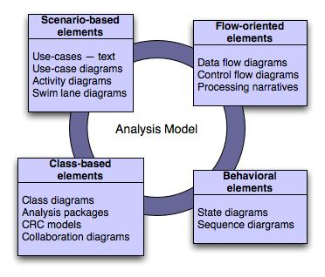
Analysis Model
Elements of the Analysis Model
<number>
Notes:
<number>

Slide 10
Analysis Model
Scenario Based Elements
Flow Oriented Elements
Class Based Elements
Behavioral Elements
<number>

Slide 11
Object-oriented Analysis (Scenario-Based Modeling)
Write Use-Cases
Develop Activity Diagram
Develop Swim lane Diagram
<number>
Notes:
<number>

Slide 12
SafeHome – Case Study
Assume that a team working for a consumer products company has provided following product description:
Our research indicates that the market for home security systems is growing at a rate of 40 percent per year. We would like to enter this market by building a microprocessor-based home security system that would protect against and/or recognize a variety of undesirable "situations" such as illegal entry, fire, flooding, and others. The product, tentatively called SafeHome, will use appropriate sensors to detect each situation, can be programmed by the homeowner, and will automatically telephone a monitoring agency when a situation is detected.
<number>

Slide 13
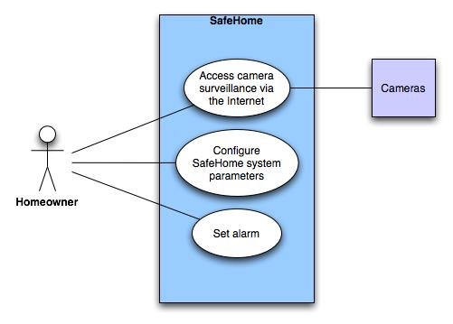
Use-case Diagram
Use-case diagram for surveillance function
<number>

Slide 14
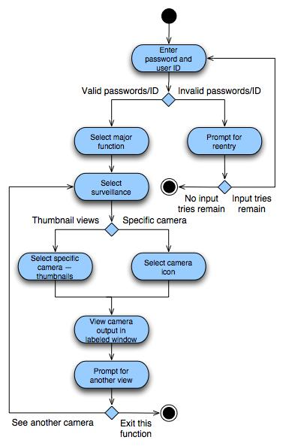
Activity diagram for Access camera surveillance—display camera views function
<number>
Notes:
<number>

Slide 15
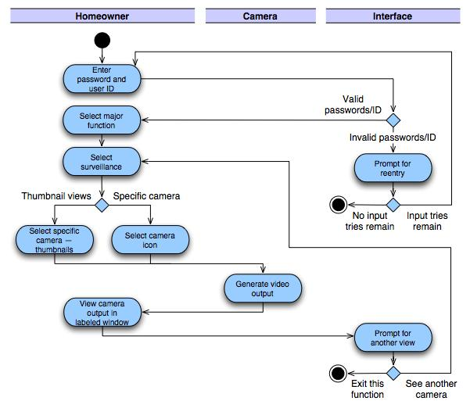
Swimlane diagram
<number>
Notes:
<number>

Slide 16
Analysis Model
Scenario Based Elements
Flow Oriented Elements
Class Based Elements
Behavioral Elements
<number>

Slide 17
Flow-Oriented Modeling (Structured Analysis)
Guidelines
Depict the system as single bubble in level 0.
Carefully note primary input and output.
Label all elements with meaningful names.
Maintain information conformity between levels.
Refine one bubble at a time.
<number>

Slide 18
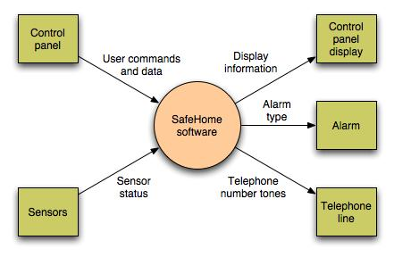
Data Flow Diagram
Context-level DFD for SafeHome security function
<number>
Notes:
<number>

Slide 19
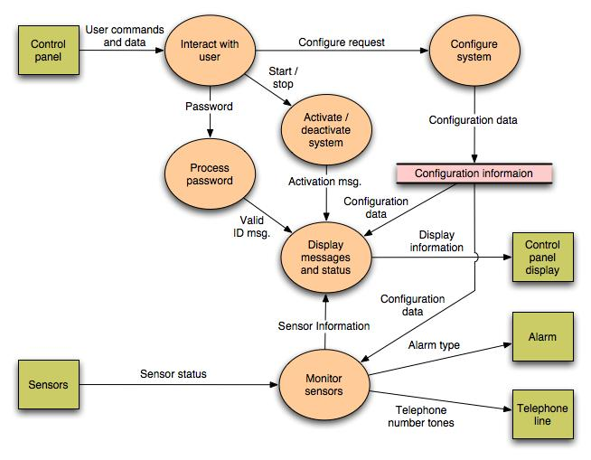
<number>
Notes:
<number>

Slide 20
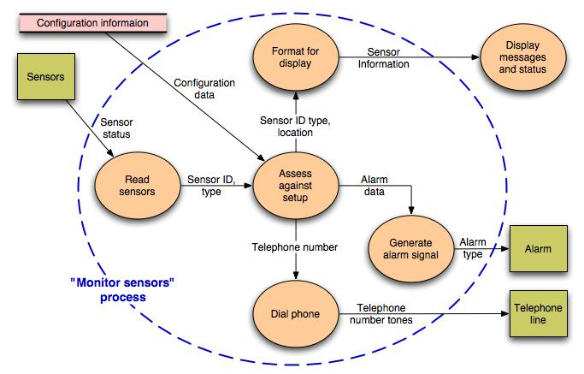
Level 2 DFD that refines the monitor sensors process
<number>
Notes:
<number>

Slide 21
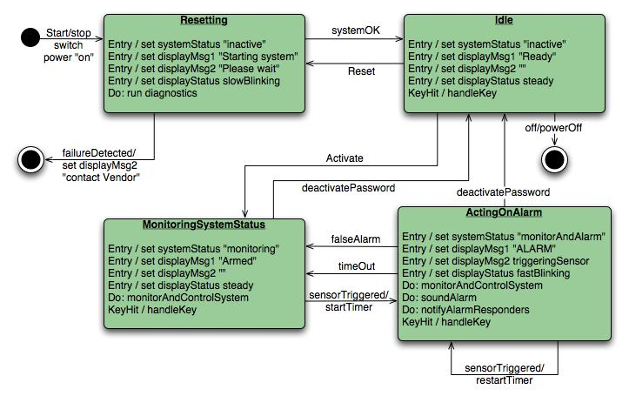
Control Flow Diagram
State diagram for SafeHome security function
<number>
Notes:
<number>

Slide 22
Analysis Model
Scenario Based Elements
Flow Oriented Elements
Class Based Elements
Behavioral Elements
<number>

Slide 23
Identifying Analysis Classes
Common technique for identifying classes in the context of a software problem is to perform a grammatical parse on the processing narrative for the system.
All nouns become potential objects.
<number>
Notes:
<number>

Slide 24
Identifying Analysis Classes
E.g.
External entities
Things
Occurrences
Events
Roles
Organizational units
Places
Structures.
<number>
Notes:
<number>

Slide 25
Class Selection Characteristics
Retained information
If information about it must be remembered so that the system can function.
Needed services
Operations that can change the value of its attributes
Multiple attributes
During requirements analysis, the focus should be on "major" information
An object with a single attribute may be useful during design but is probably better represented as an attribute of another object during the analysis activity.
<number>
Notes:
<number>

Slide 26
Class Selection Characteristics
Common attributes
Attributes should apply to all occurrences of the object.
Common operations
Operations should apply to all occurrences of the object.
Essential requirements
External entities that appear in the problem space and produce or consume information that is essential to the operation of any solution for the system will almost always be defined as class in the requirements model.
<number>

Slide 27
Identifying Classes
Potential class | Classification | Accept / Reject
homeowner | role; external entity | reject: 1, 2 fail
sensor | external entity | accept
control panel | external entity | accept
installation | occurrence | reject
(security) system | thing | accept
number, type | not objects, attributes | reject: 3 fails
master password | thing | reject: 3 fails
telephone number | thing | reject: 3 fails
sensor event | occurrence | accept
audible alarm | external entity | accept: 1 fails
monitoring service | organizational unit; ee | reject: 1, 2 fail
<number>

Slide 28
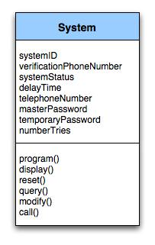
Class Diagram
Class diagram for the system class
<number>
Notes:
<number>

Slide 29
Class Responsibilities
Guidelines for allocating responsibilities to classes:
System intelligence should be evenly distributed
Each responsibility should be stated as generally as possible
Abstraction →Polymorphism
Information and the behavior related to it should reside within the same class.
Encapsulation
Information about one thing should be localized with a single class, not distributed across multiple classes
Responsibilities should be shared among related classes, when appropriate.
<number>
Notes:
<number>

Slide 30
Class Collaborations
Classes fulfill their responsibilities in one of two ways:
A class can use its own operations to manipulate its own attributes, thereby fulfilling a particular responsibility, or
a class can collaborate with other classes
Relationships between classes:
is-part-of — used when classes are part of an aggregate class.
has-knowledge-of — used when one class must acquire information from another class.
depends-on — used in all other cases.
<number>

Slide 31
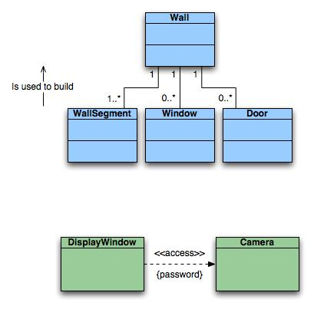
Class Diagrams
Top: Multiplicity
Bottom: Dependencies
<number>
Notes:
<number>

Slide 32
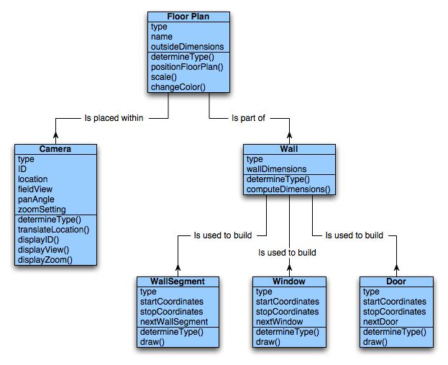
Class diagram for FloorPlan
<number>
Notes:
<number>

Slide 33
CRC Modeling
Class responsibility collaborator (CRC) modeling provides a simple means for identifying and organizing the classes that are relevant to system or product requirements.
<number>

Slide 34
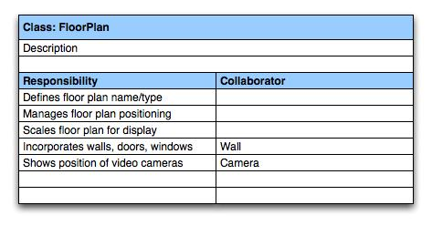
CRC Modeling
A CRC model index card for FloorPlan class
<number>
Notes:
<number>

Slide 35
Analysis Model
Scenario Based Elements
Flow Oriented Elements
Class Based Elements
Behavioral Elements
<number>

Slide 36
Identifying Events
A use-case is examined for points of information exchange.
The homeowner uses the keypad to key in a four-digit password.
The password is compared with the valid password stored in the system.
If the password in incorrect, the control panel will beep once and reset itself for additional input.
If the password is correct, the control panel awaits further action.
<number>

Slide 37
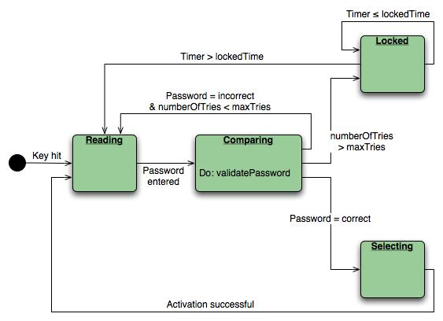
State Diagram
State diagram for the ControlPanel class
<number>
Notes:
<number>

Slide 38
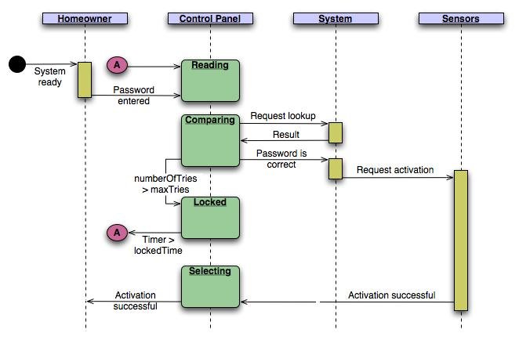
Sequence Diagram
Sequence diagram (partial) for the SafeHome security function
<number>
Notes:
<number>

Slide 39
END
<number>

